Slide 1
DFT and FFT
FFT is an algorithm to convert a time domain signal to DFT efficiently.
FFT is not unique. Many algorithms are available.
Each algorithm has merits and demerits.
In each algorithm, depending on the sequence needed at the output, the input is regrouped.
The groups are decided by the number of samples.

Slide 2
FFTs
The number of points can be nine too.
It can be 15 as well.
Any number in multiples of two integers.
It can not be any prime number.
It can be in the multiples of two prime numbers.

Slide 3
FFTs
The purpose of this series of lectures is to learn the basics of FFT algorithms.
Algorithms having number of samples 2^{N}, where N is an integer is most preferred.
8 point radix-2 FFT by decimation is used from learning point of view.
Radix-x: here ‘x’ represents number of samples in each group made at the first stage. They are generally equal.
We shall study radix-2 and radix-3.

Slide 4
Radix-2: DIT or, DIF
Radix-2 is the first FFT algorithm. It was proposed by Cooley and Tukey in 1965.
Though it is not the efficient algorithm, it lays foundation for time-efficient DFT calculations.
The next slide shows the saving in time required for calculations with radix-2.
The algorithms appear either in
(a) Decimation In Time (DIT), or,
(b) Decimation In Frequency (DIF).
DIT and DIF, both yield same complexity and results. They are complementary.
We shall stress on 8 to radix 2 DIT FFT.

Slide 5
Other popular Algorithms
Besides many, the popular algorithms are:
Goertzel algorithm
Chirp Z algorithm
Index mapping algorithm
Split radix in prime number algorithm.
have modified approach over radix-2.
Split radix in prime number does not use even the twiddles.
We now pay attention to 8/radix-2 butterfly FIT FFT algorithm.

Slide 6
Relationship between exponential forms and twiddle factors (W) for Periodicity = N
Sr. No. | Exponential form | Symbolic form
01 | e^{-j2πn/N} = e^{-j2π(n+N)/N} | W_{N}^{n} = W_{N}^{n+N}
02 | e^{-j2π(n+N/2)/N} = ⁻ e^{-j2πn/N} | W_{N}^{n+N/2}= - W_{N}^{n}
03 | e^{-j2πk} = e^{-j2πNk/N} = 1 | W_{N}^{N+K} = 1
04 | e^{-j2(2π/N)} = e^{-j2π/(N/2)} | W_{N}² = W_{N/2}

Slide 7
Values of various twiddles W_{N}^{n} for length N=8
n | W_{N}^{n} = e^{(-j2π)(n/N)} | Remarks
0 | 1 = 1∠0 | W_{N} ⁰
1 | (1-j)/√2 = 1 ∠-45° | W_{N} ¹
2 | -j = 1 ∠-90° | W_{N} ²
3 | - (1+j)/√2 = 1∠-135° | W_{N} ³
4 | -1 = 1 ∠-180° | W_{N} ⁴ = -W_{N} ⁰
5 | - (1-j)/√2 = 1 ∠-225° | W_{N} ⁵ = -W_{N} ¹
6 | j = 1 ∠90° | W_{N} ⁶ = -W_{N} ²
7 | (1+j)/√2 = 1 ∠45° | W_{N} ⁷ = -W_{N} ³

Slide 8
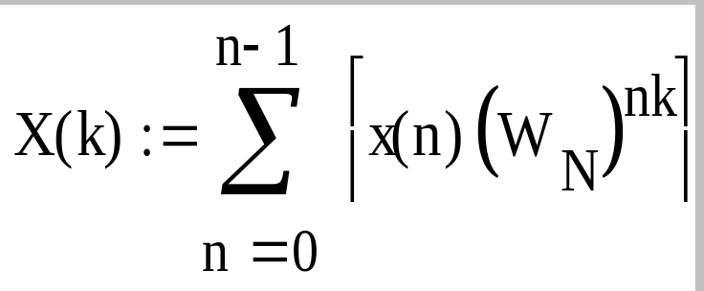
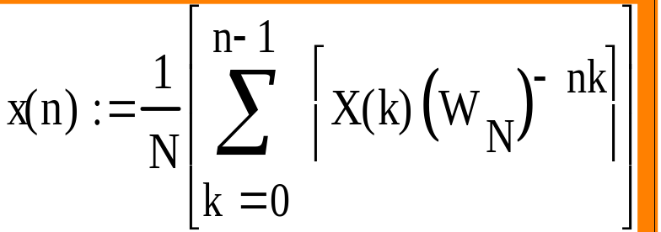
DFT calculations
The forward DFT, frequency domain output in the range 0≤k≤N-1 is given by:
While the Inverse DFT, time domain output, again, in the range 0≤k≤N-1 is denoted by

Slide 9
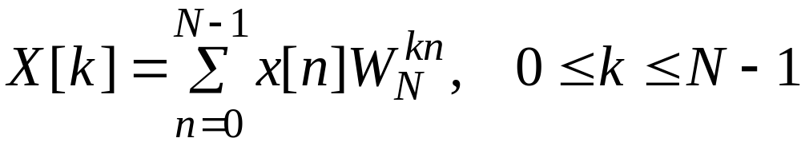
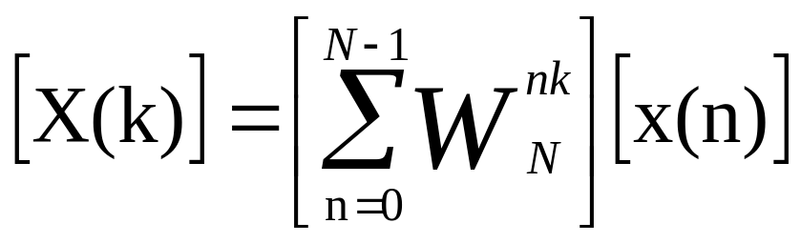
Matrix Relations
The DFT samples defined by
can be expressed in NxN matrix as
where

Slide 10
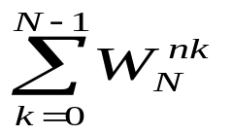
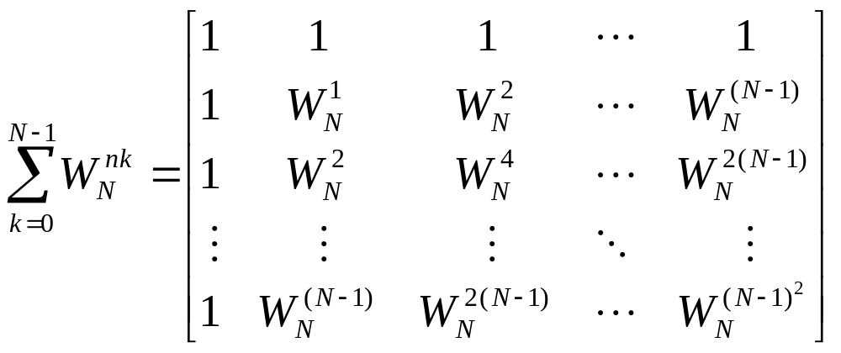
Matrix Relations
can be expanded as NXN DFT matrix

Slide 11
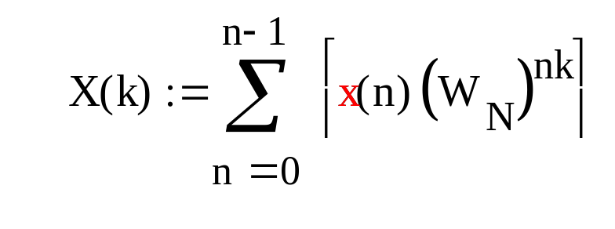
DFT:
For N of length 4,range of n, k = [0 1 2 3] each.
Hence X(n) = x(0)W_{N}^{n.0}+x(1)W_{N}^{n.1}+x(2)W_{N}^{n.2} + x(3)W_{N}^{n.3}
 |  | x(0) | x(1) | x(2) | x(3)
X(0) | = | W₄^{0x0} | W₄^{0x1} | W₄^{0x2} | W₄^{0x3}
X(1) | = | W₄^{1x0} | W₄^{1x1} | W₄^{1x2} | W₄^{1x3}
X(2) | = | W₄^{2x0} | W₄^{2x1} | W₄^{2x2} | W₄^{2x3}
X(3) | = | W₄^{3x0} | W₄^{3x1} | W₄^{3x2} | W₄^{3x3}

Slide 12
 |  | x(0) | x(1) | x(2) | x(3)
X(0) | = | W₄^{0x0} | W₄^{0x1} | W₄^{0x2} | W₄^{0x3}
X(1) | = | W₄^{1x0} | W₄^{1x1} | W₄^{1x2} | W₄^{1x3}
X(2) | = | W₄^{2x0} | W₄^{2x1} | W₄^{2x2} | W₄^{2x3}
X(3) | = | W₄^{3x0} | W₄^{3x1} | W₄^{3x2} | W₄^{3x3}
Can be rewritten as:
 |  | x(0) | x(1) | x(2) | x(3)
X(0) | = | W₄⁰ | W₄⁰ | W₄⁰ | W₄⁰
X(1) | = | W₄⁰ | W₄¹ | W₄² | W₄³
X(2) | = | W₄⁰ | W₄² | W₄⁴ | W₄⁶
X(3) | = | W₄⁰ | W₄³ | W₄⁶ | W₄⁹

Slide 13
 |  | x(0) | x(1) | x(2) | x(3)
X(0) | = | W₄⁰ | W₄⁰ | W₄⁰ | W₄⁰
X(1) | = | W₄⁰ | W₄¹ | W₄² | W₄³
X(2) | = | W₄⁰ | W₄² | W₄⁴ | W₄⁶
X(3) | = | W₄⁰ | W₄³ | W₄⁶ | W₄⁹
 |  | x(0) | x(1) | x(2) | x(3)
X(0) | = | W₄⁰ | W₄⁰ | W₄⁰ | W₄⁰
X(1) | = | W₄⁰ | W₄¹ | W₄² | -W₄¹
X(2) | = | W₄⁰ | W₄² | W₄⁰ | W₄²
X(3) | = | W₄⁰ | -W₄¹ | W₄² | W₄¹

Slide 14
 |  | x(0) | x(1) | x(2) | x(3)
X(0) | = | W₄⁰ | W₄⁰ | W₄⁰ | W₄⁰
X(1) | = | W₄⁰ | W₄¹ | W₄² | -W₄¹
X(2) | = | W₄⁰ | W₄² | W₄⁰ | W₄²
X(3) | = | W₄⁰ | -W₄¹ | W₄² | W₄¹
 |  | x(0) | x(1) | x(2) | x(3)
X(0) | = | 1 | 1 | 1 | 1
X(1) | = | 1 | -j | -1 | j
X(2) | = | 1 | -1 | 1 | -1
X(3) | = | 1 | j | -1 | -j

Slide 15
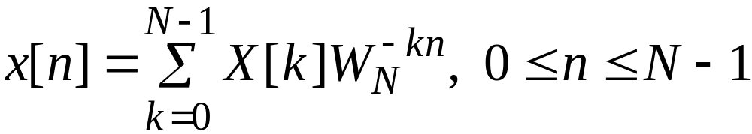
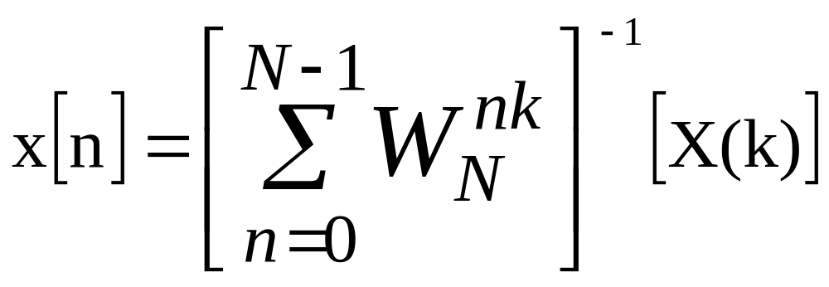
Matrix Relations
Likewise, the IDFT is
can be expressed in NxN matrix form as

Slide 16
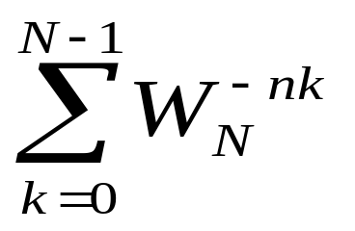
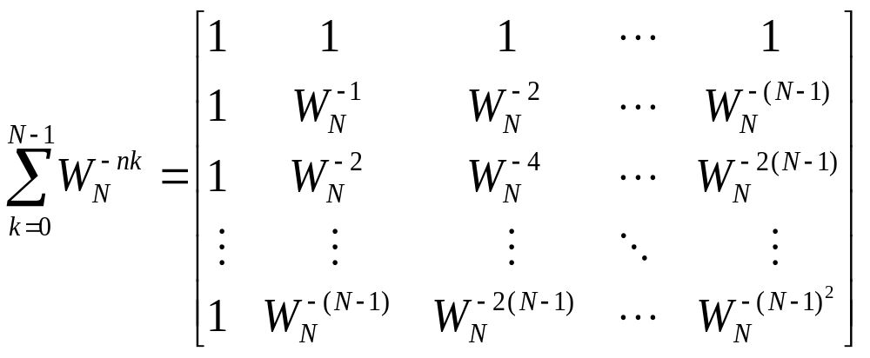
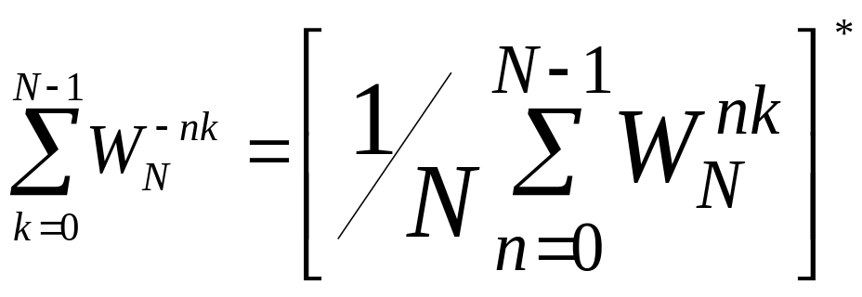
Matrix Relations
can also be expanded as NXN DFT matrix
Observe:
The inversion can be had by Hermitian conjugating j by –j and dividing by N.

Slide 17
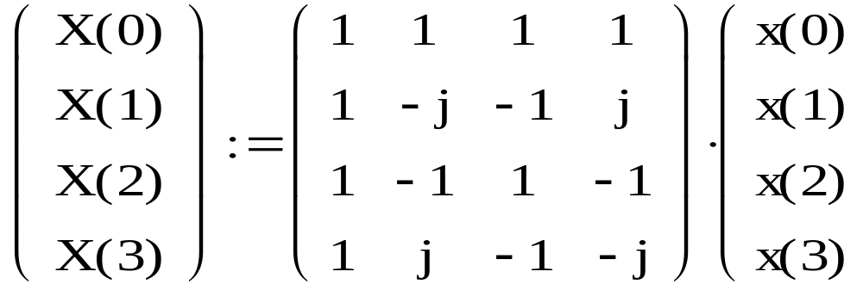
 |  | x(0) | x(1) | x(2) | x(3)
X(0) | = | 1 | 1 | 1 | 1
X(1) | = | 1 | -j | -1 | j
X(2) | = | 1 | -1 | 1 | -1
X(3) | = | 1 | j | -1 | -j
Characterisitc or system matrix

Slide 18
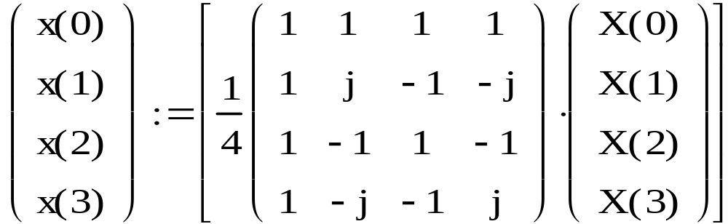
The effective determinant of above is 1/4.
Conversion in system matrices of DFT and IDFT obtained by replacing by j by –j.
Inversion of above matrix is:

Slide 19
FOR 8 point DFT: N=8
The system Matrix is:
W₈^{0x0} | W₈^{0x1} | W₈^{0x2} | W₈^{0x3} | W₈^{0x4} | W₈^{0x5} | W₈^{0x6} | W₈^{0x7}
W₈^{1x0} | W₈^{1x1} | W₈^{1x2} | W₈^{1x3} | W₈^{1x4} | W₈^{1x5} | W₈^{1x6} | W₈^{1x7}
W₈^{2x0} | W₈^{2x1} | W₈^{2x2} | W₈^{2x3} | W₈^{2x4} | W₈^{2x5} | W₈^{2x6} | W₈^{2x7}
W₈^{3x0} | W₈^{3x1} | W₈^{3x2} | W₈^{3x3} | W₈^{3x4} | W₈^{3x5} | W₈^{3x6} | W₈^{3x7}
W₈^{4x0} | W₈^{4x1} | W₈^{4x2} | W₈^{4x3} | W₈^{4x4} | W₈^{4x5} | W₈^{4x6} | W₈^{4x7}
W₈^{5x0} | W₈^{5x1} | W₈^{5x2} | W₈^{5x3} | W₈^{5x4} | W₈^{5x5} | W₈^{5x6} | W₈^{5x7}
W₈^{6x0} | W₈^{6x1} | W₈^{6x2} | W₈^{6x3} | W₈^{6x4} | W₈^{6x5} | W₈^{6x6} | W₈^{6x7}
W₈^{7x0} | W₈^{7x1} | W₈^{7x2} | W₈^{7x0} | W₈^{7x4} | W₈^{7x5} | W₈^{7x6} | W₈^{7x7}

Slide 20
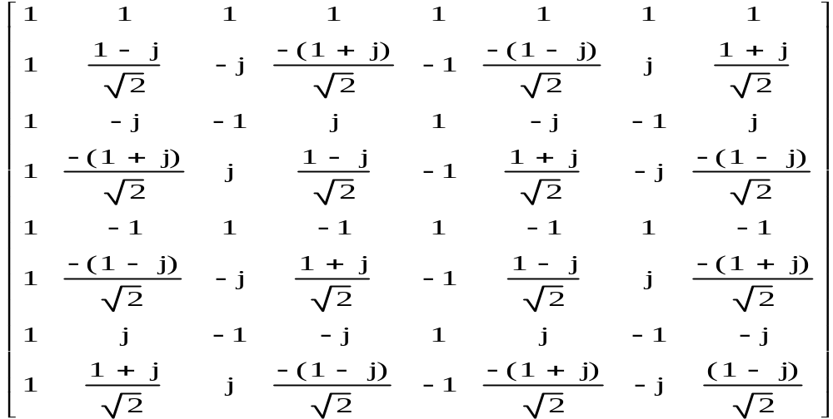
The characteristic matrix of 8-point DFT is:

Slide 21
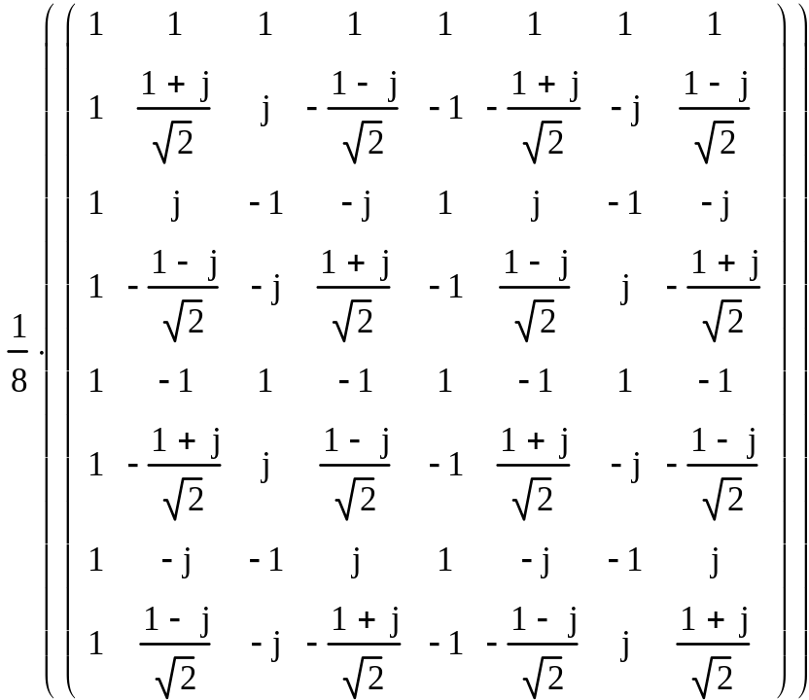
DFT and its Inverse
Conversion in system matrices of DFT and IDFT obtained by replacing by j by –j..
DFT
Effective
determinant
IDFT

Slide 22
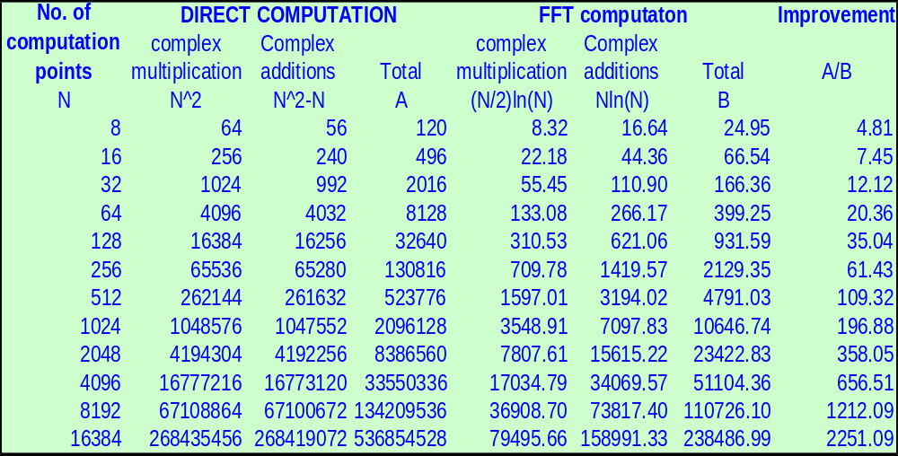
Calculation advantage in radix-2 algorithms for various values of N

Slide 23
The Process of Decimation
First step of process of decimation is splitting a sequence in smaller sequences.
A sequence of 15 can be splitted in five sequences of threes or three sequences of fives.
A sequence of 16 numbers can be splitted in 2 sequences of 8. Further,
  each sequence of 8 can be be splitted in two sequences of 4;
  Subsequently each sequence of 4 can be splitted in two sequences of two;
  There can be various combinations and varied complexities.

Slide 24
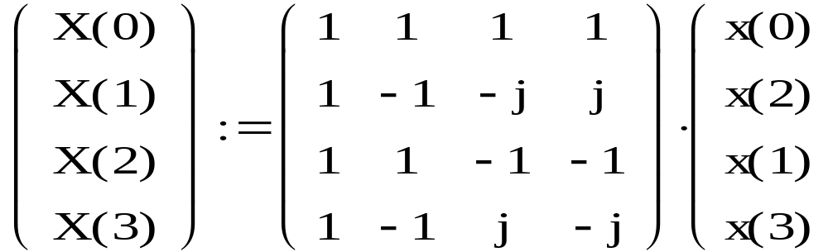
4-point DFT
Can be, by interchanging col. 2 and 3, seen as

Slide 25
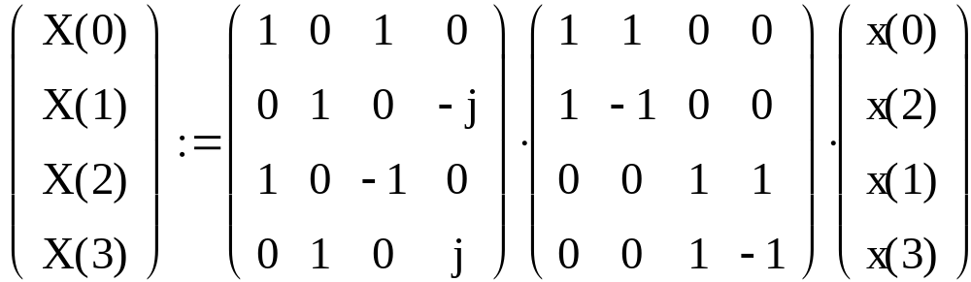
4-point DFT
The system matrix is rewritten as

Slide 26
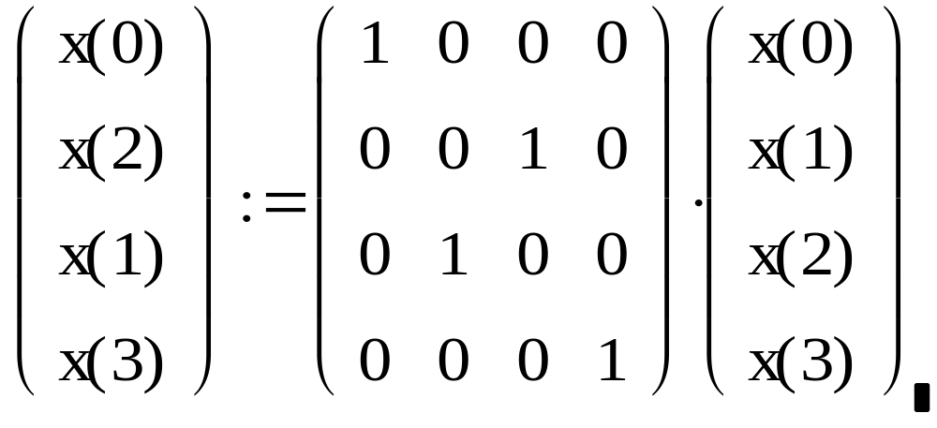
Matrix manipulation to get the desired input sequence from the actual

Slide 27
Process of decimation: example
X[n]
X[3]
X[4]
X[2]
X[6]
X[0]
-2
-1
1
5
7
n
2
3
4
6
X[7]
X[1]
X[5]
Separating the above sequence for +ve ‘n’ in even and odd sequence numbers .
X[n]
X[4]
X[n]
X[3]
X[2]
X[6]
X[0]
-2
-1
1
5
7
n
-2
-1
1
5
7
n
2
3
4
6
2
3
4
6
X[7]
X[1]
X[5]
Notes:
X[2] X[2]

Slide 28
Process of decimation: example
X[n]
X[3]
X[n]
X[4]
X[2]
X[6]
X[0]
-
1
5
7
n
-
-
1
5
7
n
2
3
4
6
2
3
4
6
X[7]
X[1]
X[5]
Shift the sequence to left by one and
compress by two
Compress the even sequence by two.
X[n]
X[4]
X[n]
X[3]
X[2]
X[6]
X[0]
4
6
-
n
n
1
2
3
2
X[1]
X[7]
The compression is also called decimation
X[5]
Notes:
X[2] X[2]

Slide 29
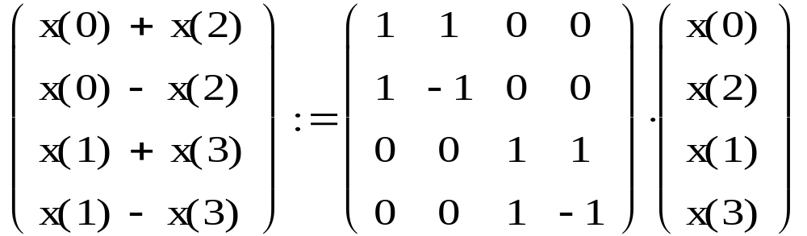
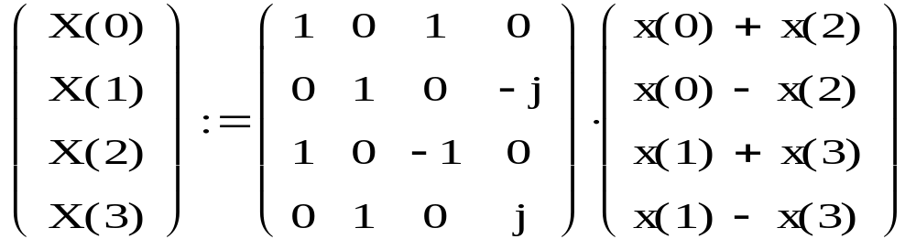
First stage of realization
Second stage

Slide 30
Decimation of 4 point DFT into 2xradix-2
x₀
x₀+x₂
X[0]
x₂
Wº→
-1
x_{o} -x₂
X[1]
w¹→
x₁+x₃
X[2]
x₁
W²↓
x₁-x₃
X[3]
x₃
-1
W³↓
The values of
W₄⁰= 1; W₄² = -1; W₄¹= -j; and W₄³ = j

Slide 31
Decimation of 4 point DFT into 2xradix-2
x₀
N/4 point
DFT
even
x₀+x₂
X[0]
x₂
Wº→
x_{o} -x₂
X[1]
w¹→
x₁+x₃
X[2]
x₁
N/4 point
DFT
odd
W²↓
x₁-x₃
X[3]
x₃
W³↓
The values of
W₄⁰= 1; W₄² = -1; W₄¹= -j; and W₄³ = j

Slide 32
N=8-point radix-4 DIT-FFT:
N/2 point
DFT
[EVEN]
X₀[0]
X[0]
X(0)
1
X₀[1]
X[1]
X(2)
X₀[2]
a→
X(4)
X[2]
X₀[3]
-j →
X(6)
X[3]
-b→
N/2 point
DFT
[ODD]
X₁ [0]
-1↓
X[4]
X(1)
X₁ [1]
-a ↓
X[5]
X(3)
X₁[2]
j↓
X[6]
X(5)
X₁[3]
b↓
X[7]
X(7)
Note: -W⁴ = W⁰=1; -W⁵= W¹ = a = (1-j)/√2;
-W² = W⁶=j and -W³ = W⁷ = b = (1+j)/√2

Slide 33
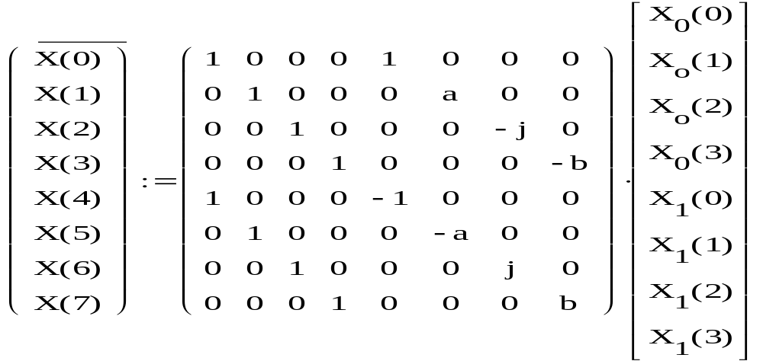
The matrix equation of the slide is:
2
1
4
3
Note the symmetry between 1st and 3rd partition
and 2nd and 4th partition of system matrix.

Slide 34
N=8-point radix-2 DIT-FFT:
N/4 point DFT
N/2 point DFT
N-point DFT
x[0]
X[0]
x[4]
X[1]
⁻¹
x[2]
X[2]
⁻¹
x[6]
w²
X[3]
-1
-1
x[1]
X[4]
-1
X[5]
x[5]
w¹
-1
-1
x[3]
w²
X[6]
-1
-1
x[7]
w²
w³
X[7]
-1
⁻¹
-1

Slide 35
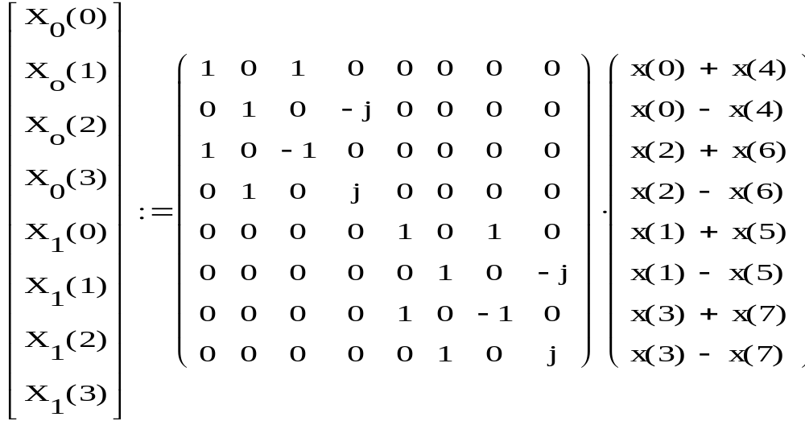


System Matrix for N/2 point DFT Block
2
3
Note that partitions 2 and 3 are null matrices while partitions 1 and 4 are identical.
Also note that subpartitions 1st and 3rd are I matrices and
2nd and 4th sub-partitions have sign difference.
Cross diagonals in either case are zero.

Slide 36
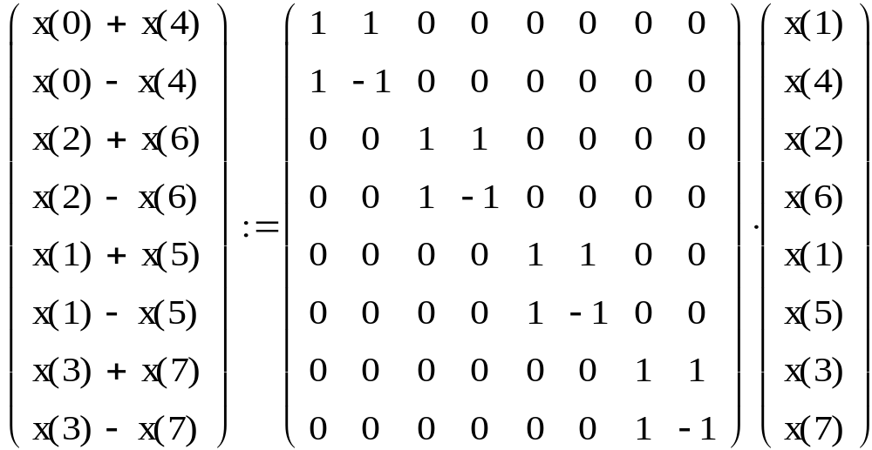
System Matrix for N/4 block
Again see the simile between 1and 4 partitions. Note that 2 and 3 s are null matrices.
Further note the sub-partition matrices. They also follow the same rule. All the elements are real.

Slide 37
Signal flow graph for decimation of 8 point DFT
N/4 point DFT
N/2 point DFT
N-point DFT
x[0]
X[0]
x[4]
X[1]
⁻¹
x[2]
X[2]
⁻¹
x[6]
w²
X[3]
-1
-1
x[1]
X[4]
-1
X[5]
x[5]
w¹
-1
-1
x[3]
w²
X[6]
-1
-1
x[7]
w²
w³
X[7]
-1
⁻¹
-1

